Slide 1
Scale-Free Adaptive Sliding-Mode Control for Guaranteed Soft-Precise Landing under Target Visibility Constraints
Presenter:
Shubham Singhal
Research Supervisors:
Dr. Jishnu Keshavan
Dr. Suresh Sundaram

Slide 2
Outline
Motivation
System Output Dynamics
Problem Statement
Controller Diagram
Research Novelty
Simulation Results
Key Objectives for Method Demonstration
Notes:
Start with motivation and Key related work
Explain optical flow and how it can ensure for soft landing
Challenges with optical flow-based landing -> understand my research problem
Present controller block diag -> help to understand research novelty
Show the experimental setup used to get experimental results
Summarize the presentation
Before concluding it with insight on future work

Slide 3
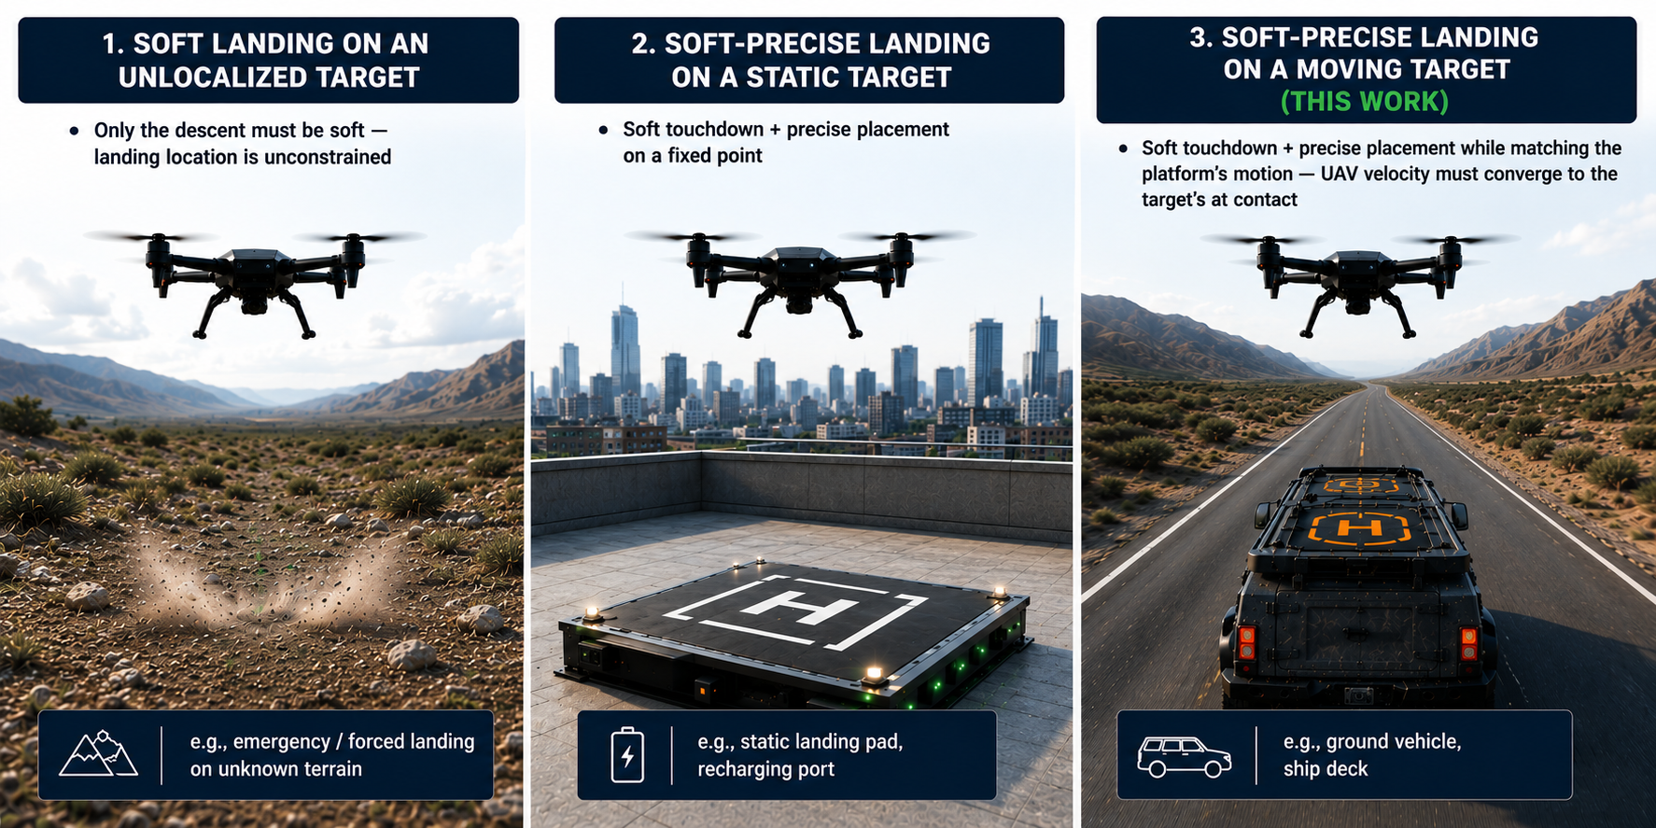
Spectrum of Autonomous Landing
*Image credits: OpenAI ChatGPT.
Notes:
Soft Landing on an Unlocalized Target
- Only the descent must be soft — landing location is unconstrained
- e.g., emergency / forced landing on unknown terrain
Soft-Precise Landing on a Static Target
- Soft touchdown + precise placement on a fixed point
- e.g., static landing pad, recharging port
Soft-Precise Landing on a Moving Target ◄ this work
- Soft touchdown + precise placement while matching the platform's motion — the UAV's velocity must converge to the target's at contact
- e.g., ground vehicle, ship deck

Slide 4
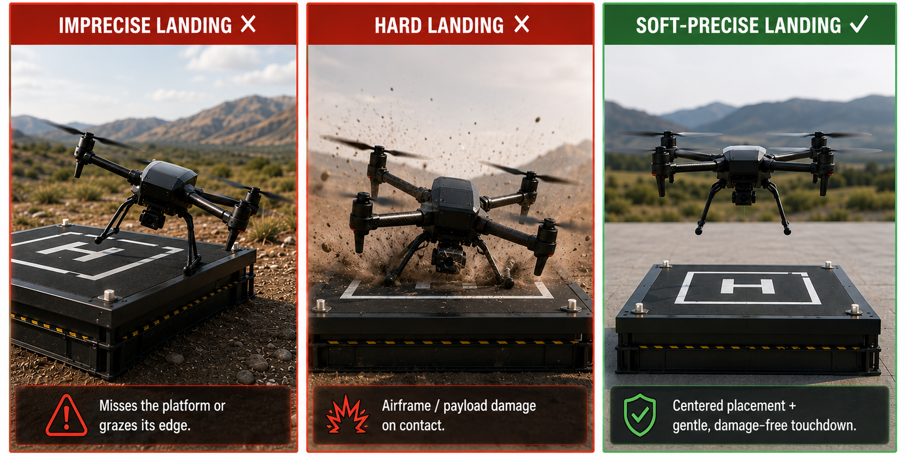
Why Soft-Precise Landing?
*Image credits: OpenAI ChatGPT.
(a) Lateral approach before touchdown (precision)
(b) Relative altitude & velocity converge at touchdown (softness)
Req. (a) + Req. (b)
⇒ soft-precise landing
Notes:
Terminal landing has two failure modes, each motivating one requirement:
Imprecise landing — misses the platform or grazes its edge → needs precise positioning
Hard landing — airframe / payload damage on contact → needs a soft touchdown
⇒ Goal: a guaranteed soft-precise landing, captured by two functional requirements:
smooth lateral approach to the target before touchdown — precision
altitude and velocity converge to the target's at touchdown — softness

Slide 5
Sensing for Soft-Precise Landing — Why Monocular Vision?
Non-Vision Sensor
Vision Sensor
INS + GNSS [Marcon 2018 IEEE PIERS]
Denied indoors, urban-canyon, and obstructed sites
LiDAR (ToF / 3D) [Kim 2017 IEEE URAI]
High SWaP-C
Platform-mounted variants add a UAV–platform comms link
UWB [Semenov 2025 IEEE SUMMA]
Needs deployed anchor infrastructure
Depends on anchor count/placement and radio-signal stability
Vision provides the natural minimal-SWaP modality [Gautam 2014 IEEE ICUAS]
Stereo Camera [Benini 2018 Control Theory Tech.]
Added SWaP-C and compute
Payload/endurance penalty on small UAVs
Monocular Camera [Nguyen 2026 Springer ICCIES]
Minimal SWaP
Only weakness is scale ambiguity
Scale ambiguity is resolved in control, not hardware → scale-free VDF-ASMC.
Notes:
Soft-precise landing needs accurate relative UAV–target position and velocity during terminal descent, in GPS-denied or unprepared sites.
Non-vision sensors — each carries a disqualifier:
- GNSS RTK / INS — denied indoors, urban-canyon, and obstructed sites [Marcon 2018 IEEE PIERS]
- UWB — needs deployed anchor infrastructure; depends on anchor count/placement and radio-signal stability [Semenov 2025 IEEE SUMMA]
- LiDAR (ToF / 3D) — high SWaP-C; platform-mounted variants add a UAV–platform comms link [Kim 2017 IEEE URAI]
Vision — the natural minimal-SWaP modality [Gautam 2014 IEEE ICUAS]
Vision detects the changes caused by applied forces, not the actual forces.
- Stereo camera — added SWaP-C and compute; payload/endurance penalty on small UAVs [Benini 2018 Control Theory Tech.]
- Monocular camera ✓ — minimal SWaP; only weakness is scale ambiguity [Bouazza 2025 arXiv, Nguyen 2026 Springer ICCIES]
➡ Scale ambiguity is resolved in control, not hardware → scale-free VDF-ASMC.

Slide 6
Landscape of Autonomous Landing Approaches
Landing Approach | Core Mechanism | Target | Sensing requirement | Representative works
Aerodynamic ground-effect | Thrust shaping near ground via induced-wind modeling | Static (ground / structure) | Aerodynamic model + IMU; no vision | [Nekoo 2021 IEEE ICUAS]; [Nekoo 2021 IEEE AIRPHARO]
Guidance / trajectory optimization | Terminal position-velocity-acceleration constraints (min-jerk) | Moving | Full metric platform state (position + velocity, prediction) | [Kumar 2024 IEEE ICARCV]
Off-board / external sensing | Platform-side sensing guides UAV | Moving | LiDAR on platform + UAV-platform comms link | [Kim 2017 IEEE URAI]
Sensor-fusion estimation | Relative-state estimation for approach | Moving | Multi-sensor fusion (IMU + range / UWB / magnetometer) | [Bouazza 2025 arXiv]; [Zhao 2012 IEEE Sensors J.]
Vision-based feedback | Visual servoing (PBVS / IBVS) and optic-flow feedback | Moving | Single monocular camera | [Lin 2022 IEEE TII]; [Zhang 2026 IEEE TIE]; [Lin 2023 IEEE TASE]; [Cho 2022 Aerosp. Sci. Technol.]; VDF-ASMC (this work)

Slide 7
Research Gap
Work | Method | Target | Metric scale needed? | Soft touchdown? | Visibility guarantee? | Key gap
[Lin 2022 IEEE TII] | PBVS + Prescribed Performance Control | Moving platform | Yes (relative position) | No explicit guarantee | Partial (PPC bounds image error) | Needs metric relative position; no soft-touchdown certificate
[Zhang 2026 IEEE TIE] | PBVS + Adaptive Extended Disturbance Observer | Fast platform | Yes (position + disturbance est.) | No - precise but not soft | No | Lands precisely but with non-zero impact velocity
[Lin 2023 IEEE TASE] | Robust circle-feature IBVS + performance funnel (PPC) | Moving vehicle | Depth-free features; needs own-velocity feedback | No explicit guarantee (funnel on image error) | Partial (funnel bounds image error) | Performance funnel fixed a priori; no soft-touchdown certificate
[Cho 2022 Aerosp. Sci. Technol.] | Feed-forward IBVS + sensor fusion | Ship deck (moving) | Yes (height/GPS fusion) | No velocity guarantee | No | Relies on sensor fusion for metric scale; no formal soft/visibility proof
VDF-ASMC (ours) | Dual-funnel ASMC (image + optic-flow funnel) | Moving target | No - scale-free | Yes — optic-flow funnel (empirical) | Yes (image funnel + cone clamp) | —
Notes:
Pose-estimation using IMU + GPS for outdoors or IMU + distance sensors for indoors.
Needs accurate pose estimation for stability. GPS + IMU or distance sensors may not give reliable information near ground.
Vision provides more accurate pose-estimates. Vision-based landing needs image sensor. Image sensors more reliable for pose-estimation.
PBVS -> Pose-estimation using image features.
But -> Involves real-time processing of massive information -> High compute cost + Adding delay -> impacting performance and stability of autonomous landing.
+ Needs accurate image scale information -> sensitive to camera calibration and image noise
IBVS - > Does not need to transform image information to inertial frame -> metric information .
No image scale information -> Robust to camera calibration + image noise
Optical Flow
Possesses inherent characteristics for soft landing. (Will show how in the next few slides.)
No feature detection $⇒$ No image segmentation $⇒$ Low computational cost.
Please note that due to the space constraint, I have just provided reference to the key related work only.

Slide 8
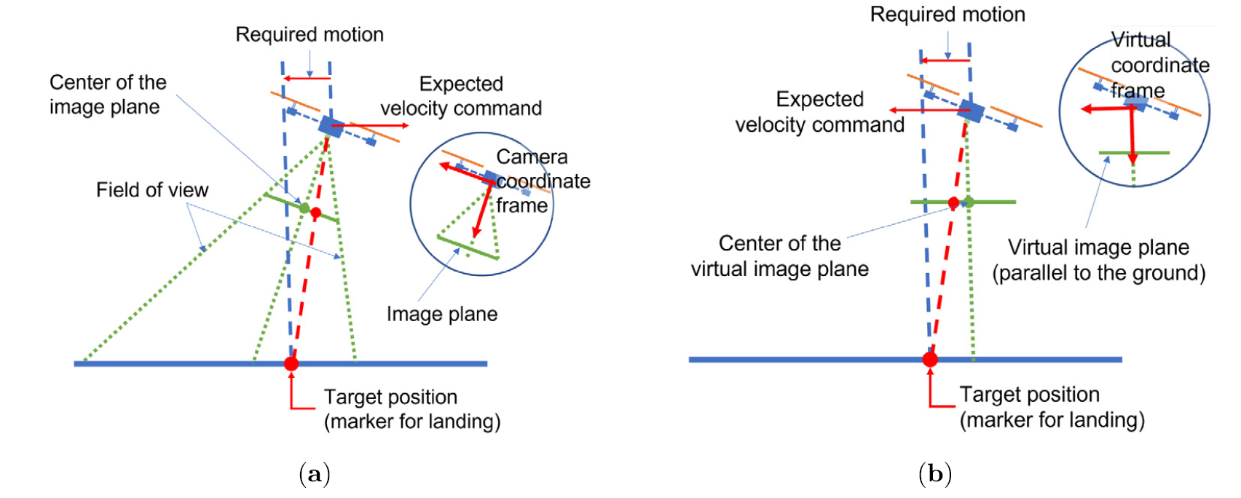
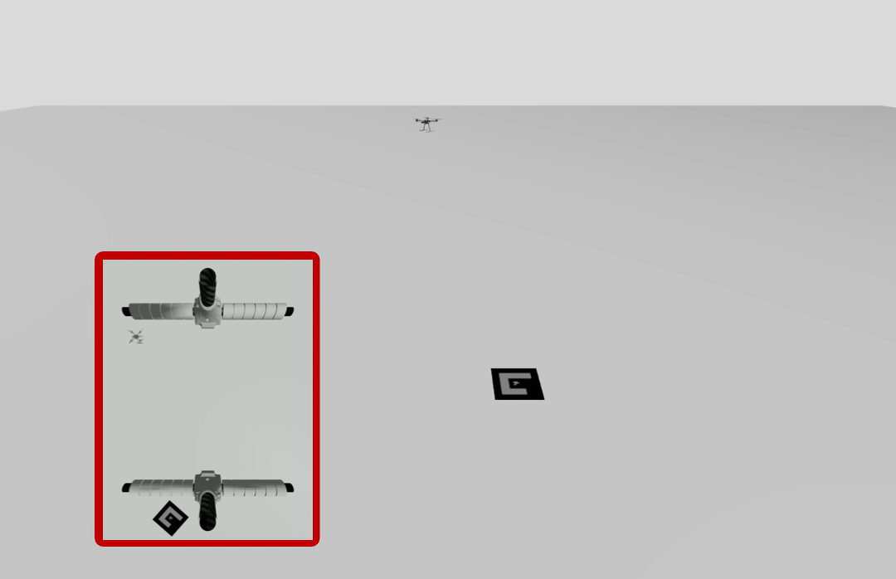
Why Virtual Image Plane?
Target image is moving out of the camera FoV when the UAV tends to move towards the target.
Projections of the target positions: (a) on the image plane and (b) on the virtual image plane. [Cho 2022 AST]

Slide 9
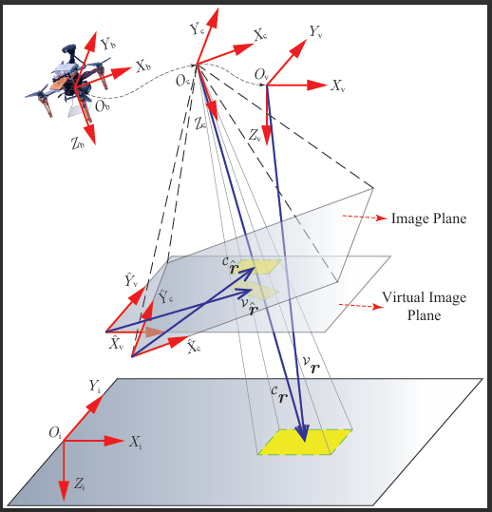

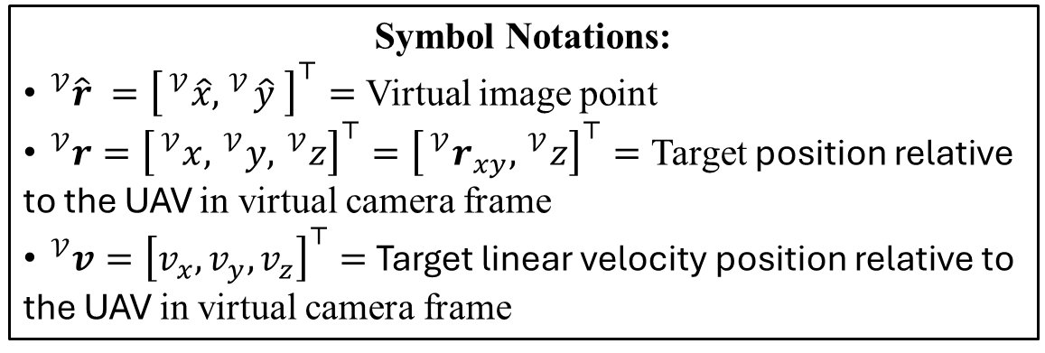
Target Image Parameters
$s=$ Virtual Image position $=\left[\begin{matrix} ^{𝒱}\hat{r} \\ 1\end{matrix}\right]=\frac{ ^{𝒱}r}{ ^{𝒱}z}$
$α=\text{Virtual} \text{Image} \text{orientation}=\frac{1}{2}\tan^{−1}{​}\left(\frac{2μ_{11}}{\left(μ_{20}−μ_{02}\right)}\right)$
$h=$Virtual Image Velocity $=\frac{ ^{𝒱}v}{ ^{𝒱}z}$
$ω=$ Virtual Image Angular Velocity Vector
Symbol Notations:
$^{𝒱}\hat{r} ={\left[ ^{𝒱}\hat{x}, ^{𝒱}\hat{y} \right]}^{⊤}=$ Virtual image point
$^{𝒱}r={\left[ ^{𝒱}x, ^{𝒱}y, ^{𝒱}z\right]}^{⊤}={\left[ ^{𝒱}r_{xy}, ^{𝒱}z\right]}^{⊤}=$ Target position relative to the UAV in virtual camera frame
$^{𝒱}v={\left[v_{x},v_{y},v_{z}\right]}^{⊤}=$ Target linear velocity position relative to the UAV in virtual camera frame

Slide 10
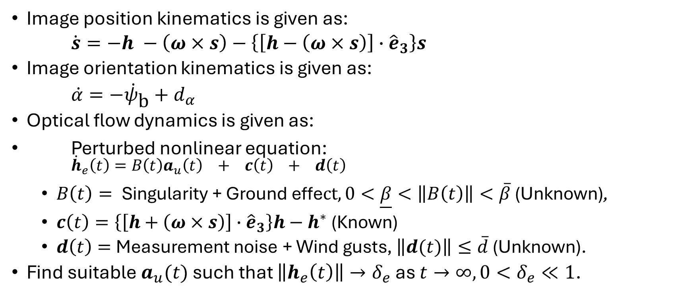
System Output Dynamics
Image position kinematics is given as:
$\dot{s}=−h −\left(ω×s\right)−\left\{\left[h−\left(ω×s\right)\right]∙{\hat{e}}_{3}\right\}s$
Image orientation kinematics is given as:
$\dot{α}=−{\dot{ψ}}_{\text{b}}+d_{α}$
Optical flow dynamics is given as:
Perturbed nonlinear equation:
${\dot{h}}_{e}\left(t\right)=B\left(t\right)a_{u}\left(t\right) + c\left(t\right) + d\left(t\right)$
$B\left(t\right)= \text{Singularity}\text{ + }\text{Ground} \text{effe}ct, 0<\underline{β}<\left\|B\left(t\right)\right\|<\overline{β} \text{(}\text{Unknown}\text{)}\text{,}$
$c\left(t\right)=\left\{\left[h+\left(ω×s\right)\right]∙{\hat{e}}_{3}\right\}h−h^{∗}$ (Known)
$d\left(t\right)=$ Measurement noise + Wind gusts, $\left\|d(t)\right\|≤\overline{d}$ (Unknown).
Find suitable $a_{u}(t)$ such that $\left\|h_{e}\left(t\right)\right\|→δ_{e}$ as $t→∞, 0<δ_{e}≪1$.

Slide 11
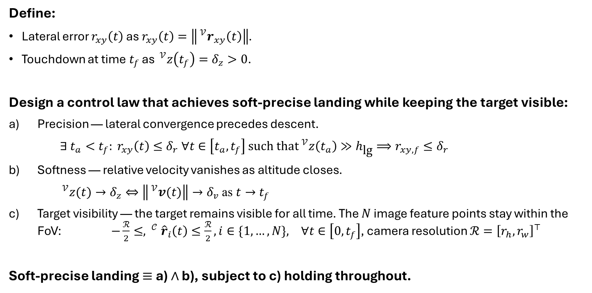
Problem Statement
Define:
Lateral error $r_{xy}\left(t\right)$ as $r_{xy}\left(t\right)=\left\| ^{𝒱}r_{xy}\left(t\right)\right\|$.
Touchdown at time$t_{f}$ as $^{𝒱}z\left(t_{f}\right)=δ_{z}>0$.
Design a control law that achieves soft-precise landing while keeping the target visible:
Precision — lateral convergence precedes descent.
$∃ t_{a}<t_{f}: r_{xy}\left(t\right)≤δ_{r} ∀t∈\left[t_{a},t_{f}\right]$ such that$^{𝒱}z\left(t_{a}\right)≫h_{\text{lg}}⟹r_{xy,f}≤δ_{r}$
Softness — relative velocity vanishes as altitude closes.
$^{𝒱}z(t)→δ_{z}⇔\left\| ^{𝒱}v(t)\right\|→δ_{v}$ as $t→t_{f}$
Target visibility — the target remains visible for all time. The $N$ image feature points stay within the FoV: $−\frac{ℛ}{2}≤, ^{𝒞}{\hat{r}}_{i}\left(t\right)≤\frac{ℛ}{2}, i∈\{1,…,N\}, ∀t∈\left[0,t_{f}\right]$, camera resolution $ℛ={\left[r_{h},r_{w}\right]}^{⊤}$
Soft-precise landing $≡$ a) $∧$ b), subject to c) holding throughout.
Notes:
Develop a control framework which will ensure the following:
Faster convergence of relative lateral UAV-target position than the convergence of relative altitude.
Simultaneous convergence of relative lateral UAV-target velocity and relative altitude.
In our control formulation, we use high proportional gain to ensure convergence of s and hence, faster convergence of r wrt to z. Additionally, we have lateral acceleration clamp which is triggered by exponentially decaying target image funnel, which guarantees target visibility.

Slide 12
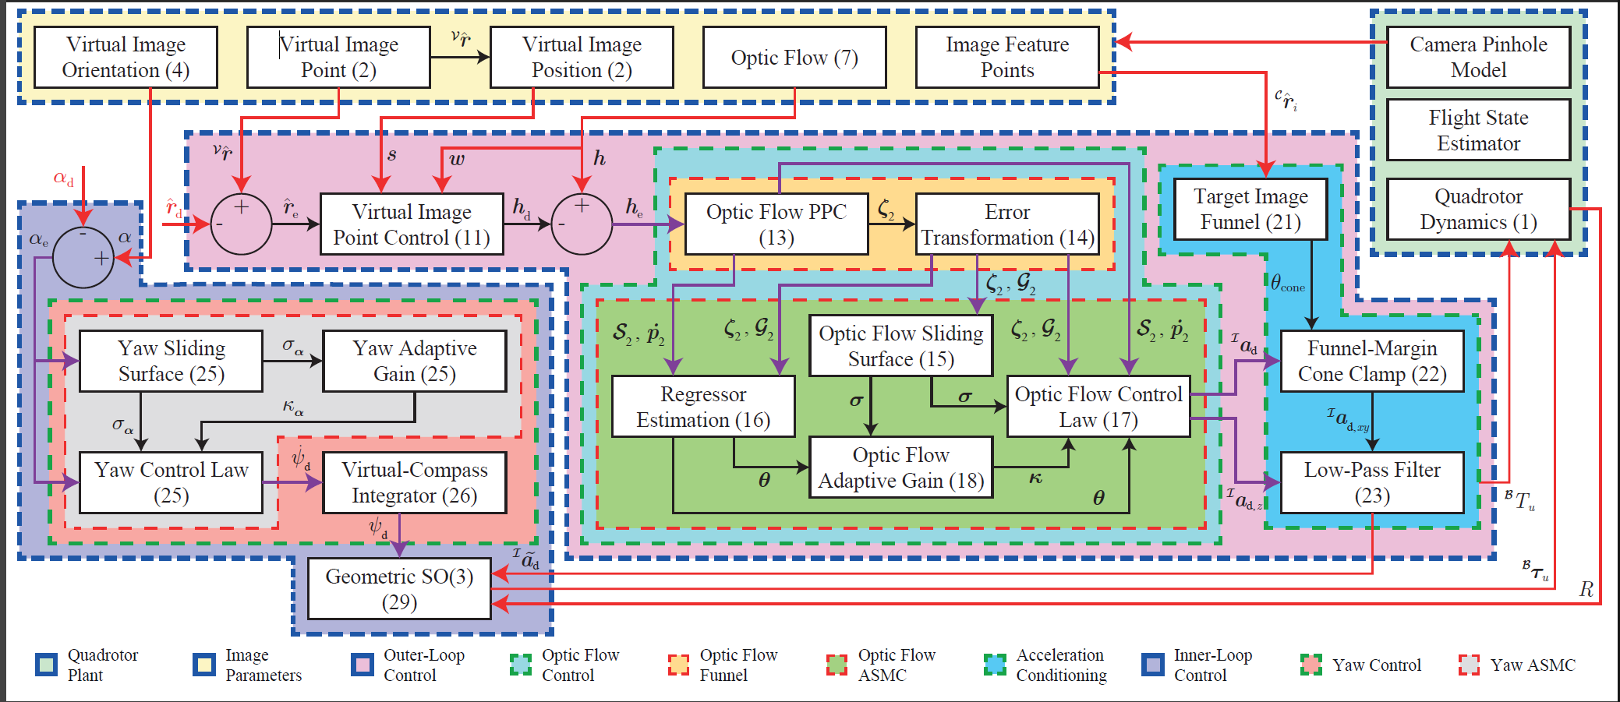
Block Diagram

Slide 13
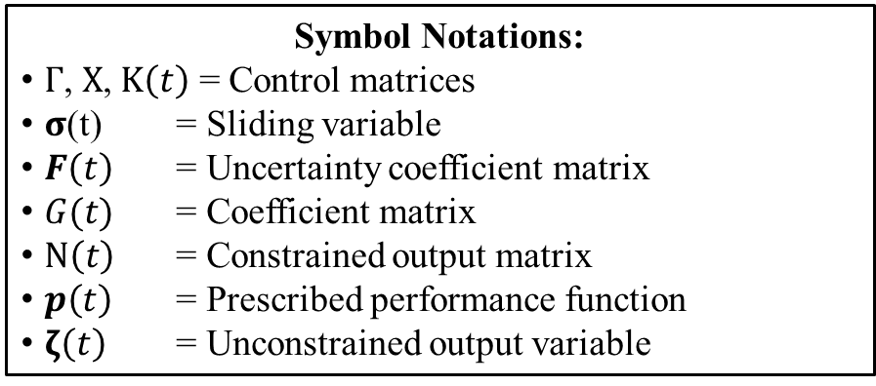

Research Novelty
Performance-constrained Leakage-type Adaptive Sliding Mode Control (PLASMC):
Equivalent control
Switching control
Control Law: $a_{u}\left(t\right)=G^{−1}\left(t\right){\hat{a}}_{u}\left(t\right)$
${\hat{a}}_{u}\left(t\right)={\left[{\hat{a}}_{u_{x}},{\hat{a}}_{u_{y}},{\hat{a}}_{u_{z}}\right]}^{⊤}$such that
${\hat{a}}_{u_{i}}\left(t\right)=−γ_{i}σ_{i}\left(t\right)+g_{i}\left(t\right)\left(−c_{i}\left(t\right)+η_{i}\left(t\right){\dot{p}}_{i}\left(t\right)\right)−χ_{i}ζ_{i}\left(t\right)$ $− κ_{i}\left(t\right){\left\|f_{i}\left(t\right)\right\|}_{2}sat\left(\frac{σ_{i}\left(t\right)}{ϵ_{i}}\right)$
with $i=\left\{x,y,z\right\}$.
Adaptive Law: ${\dot{κ}}_{i}\left(t\right)=η_{c_{i}} \left|σ_{i}\left(t\right)\right| {\left\|f_{i}\left(t\right)\right\|}_{2}− ρ_{i}η_{c_{i}}κ_{i}\left(t\right)$
Symbol Notations:
$Γ$, $X$, $Κ\left(t\right)$ = Control matrices
$σ$(t) = Sliding variable
$F\left(t\right)$ = Uncertainty coefficient matrix
$G(t)$ = Coefficient matrix
$N\left(t\right)$ = Constrained output matrix
$p\left(t\right)$ = Prescribed performance function
$ζ\left(t\right)$ = Unconstrained output variable
Equivalent Control
Switching Control
Notes:
Equivalent control:
Main control action $⟹$ Drive flow error to sliding surface.
Forces error to evolve on sliding surface while $σ\left(t\right)→0$.
Switching control:
Ensures discontinuity of control law across sliding surface.
Supplies additional control to adapt to system uncertainty, without any knowledge of $\overline{β}$, $\overline{∆}$.
Feedback linearization:
Compensate for non-linearity and actuator saturation.

Slide 14
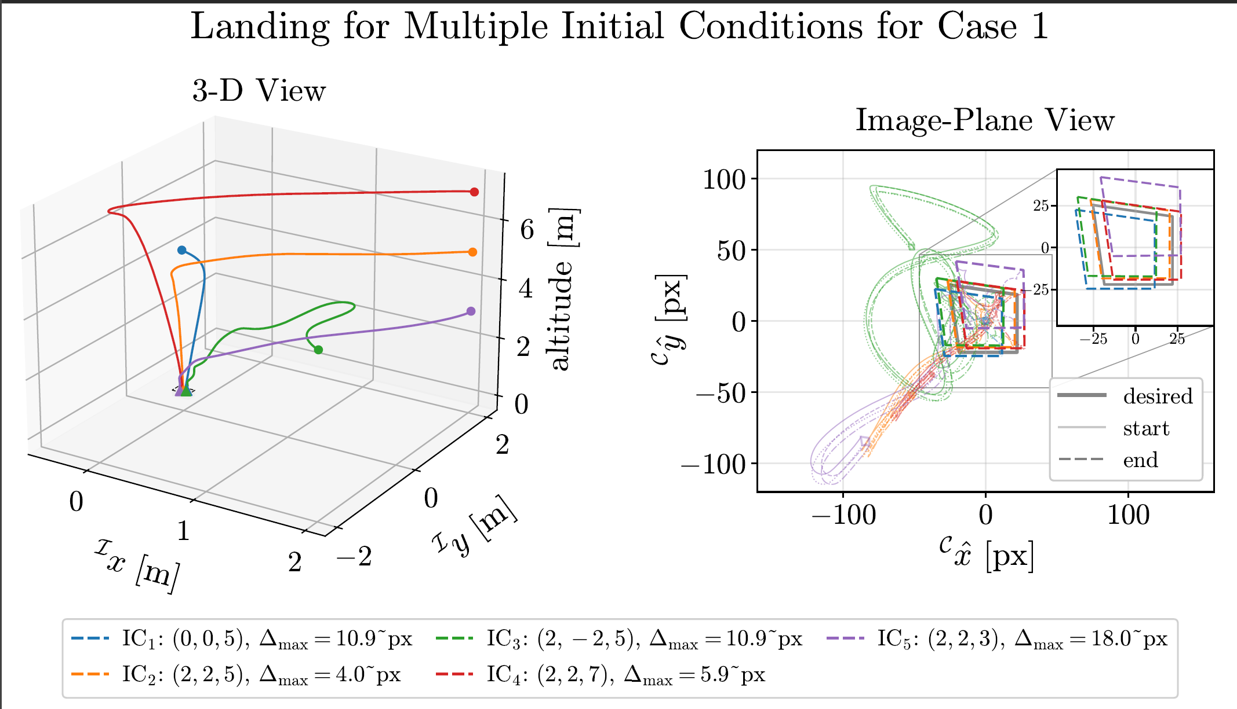
Simulation Results

Slide 15
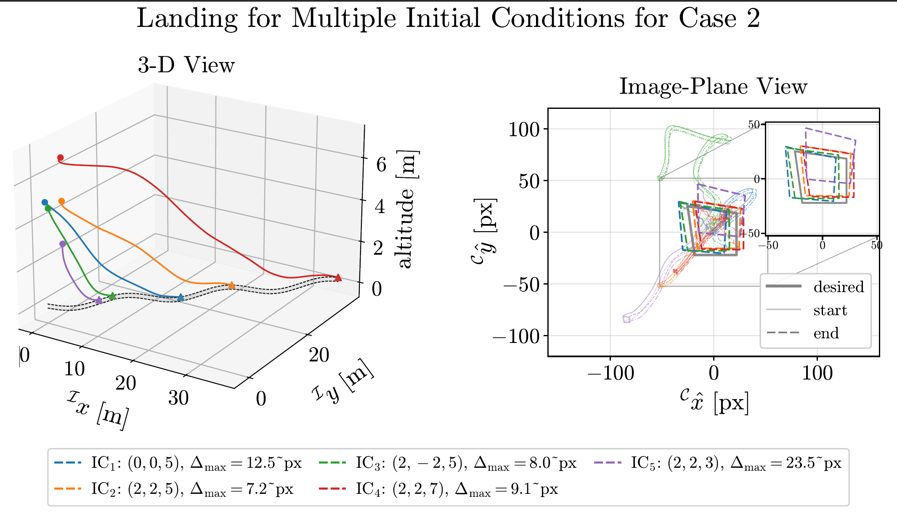
Simulation Results

Slide 16
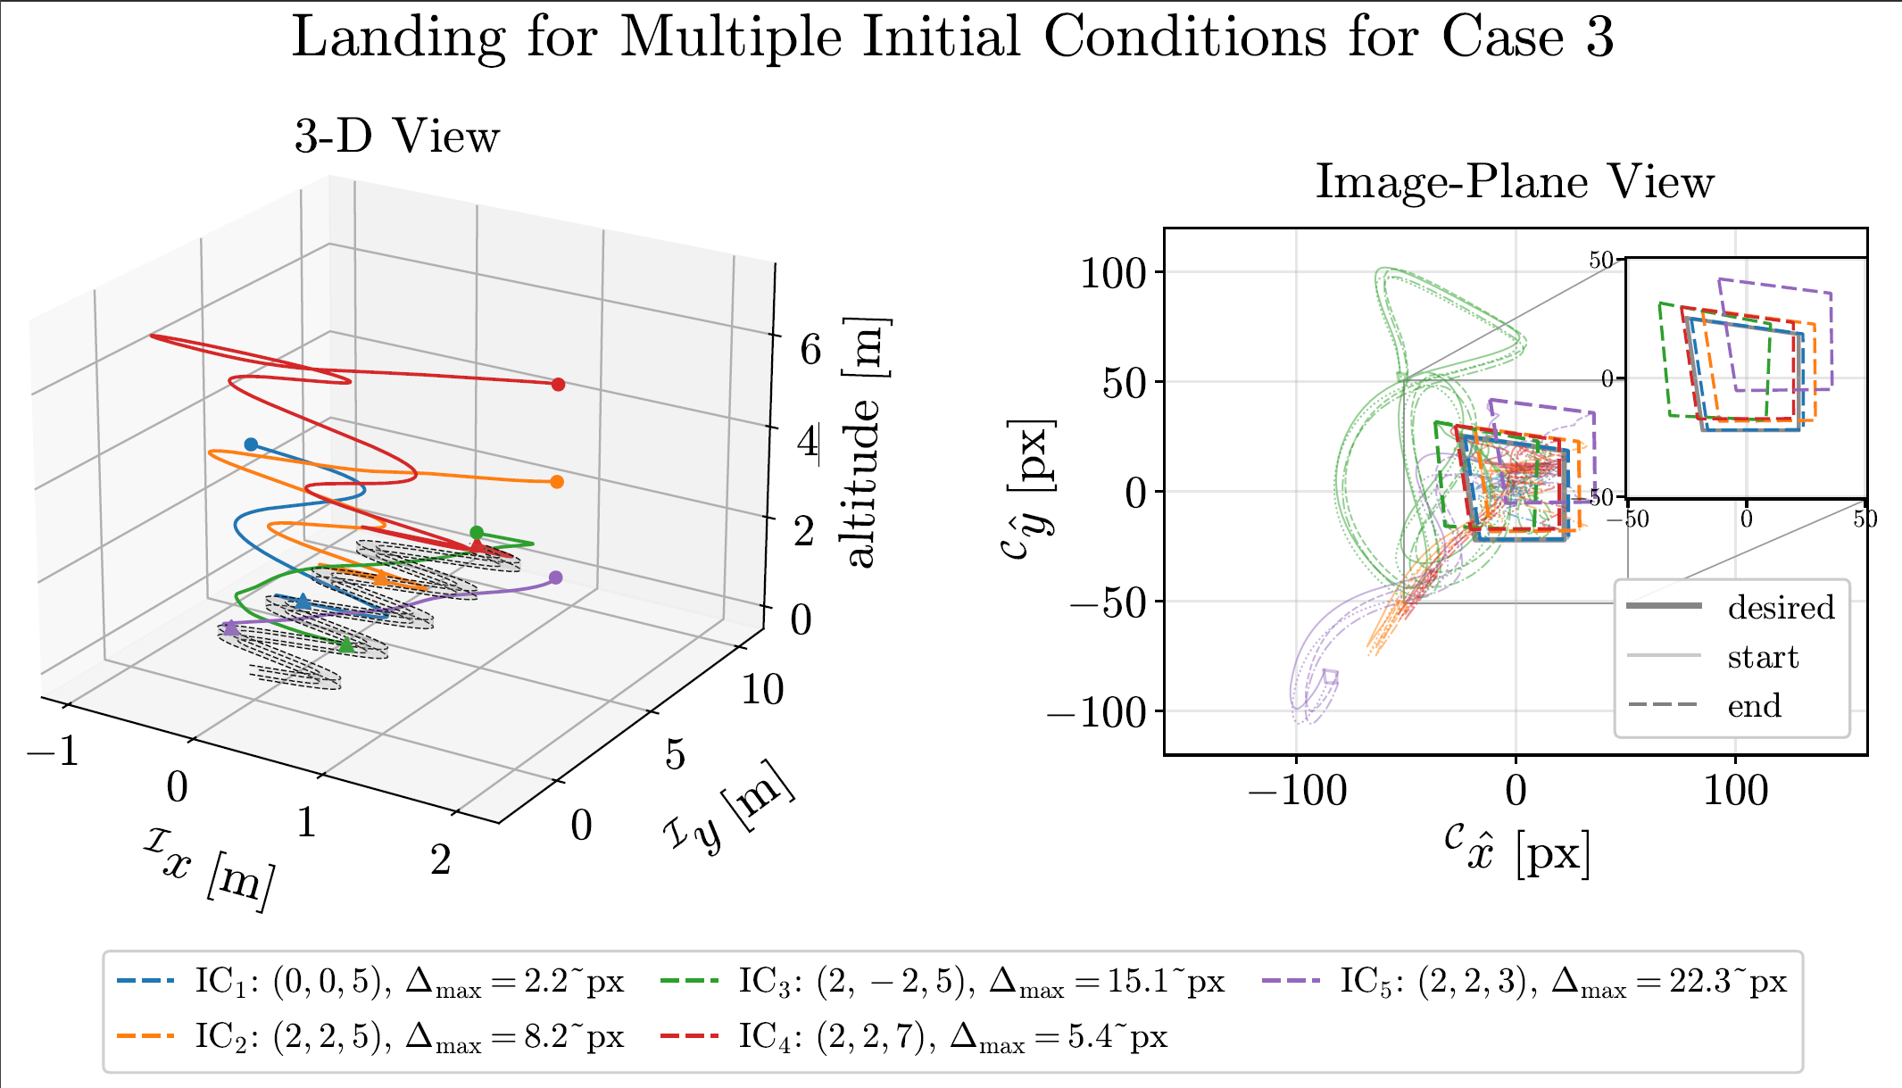
Simulation Results

Slide 17
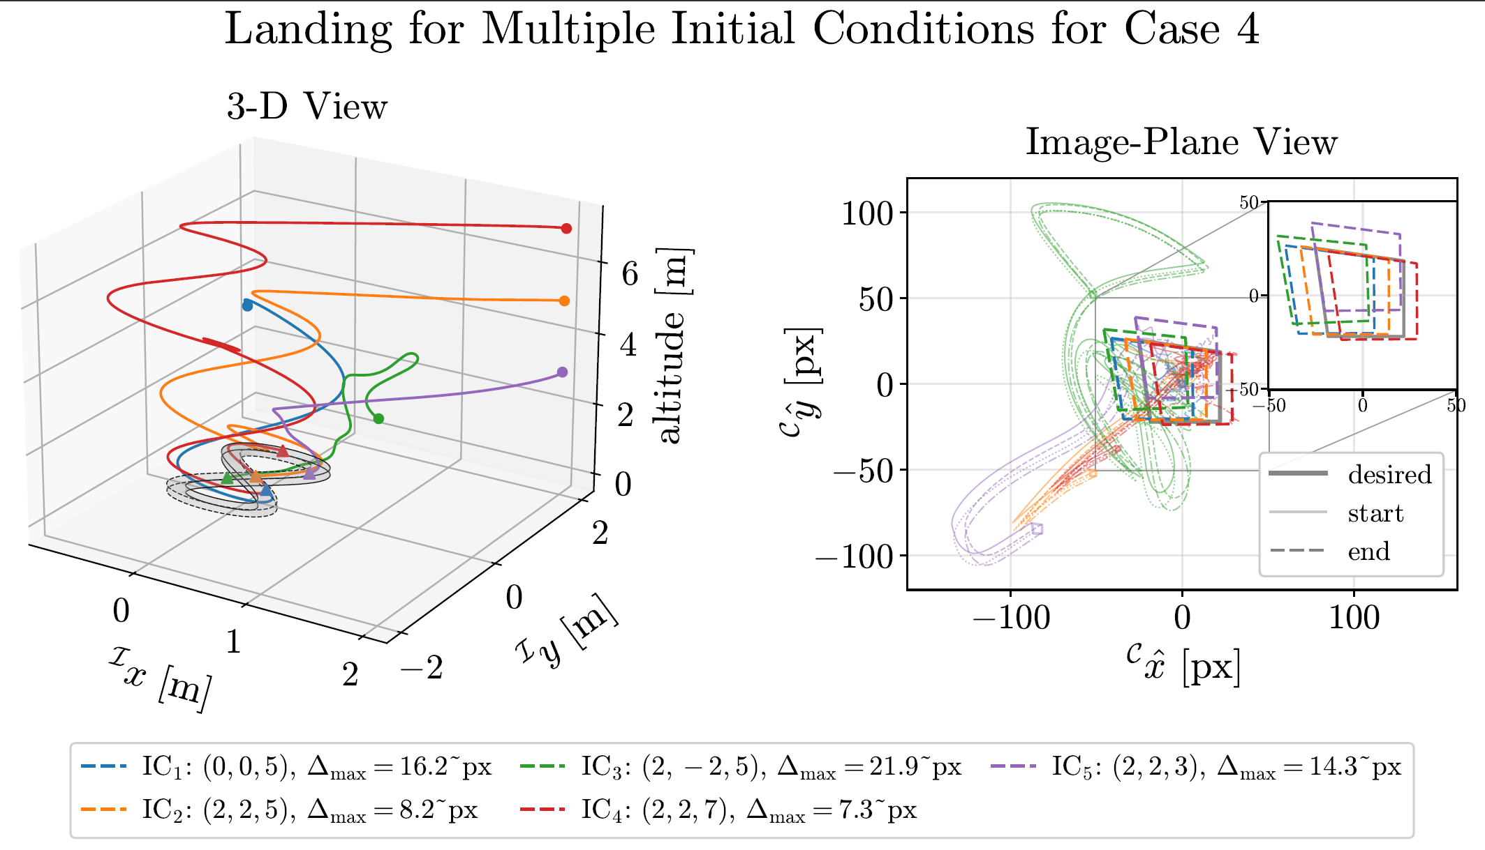
Simulation Results

Slide 18
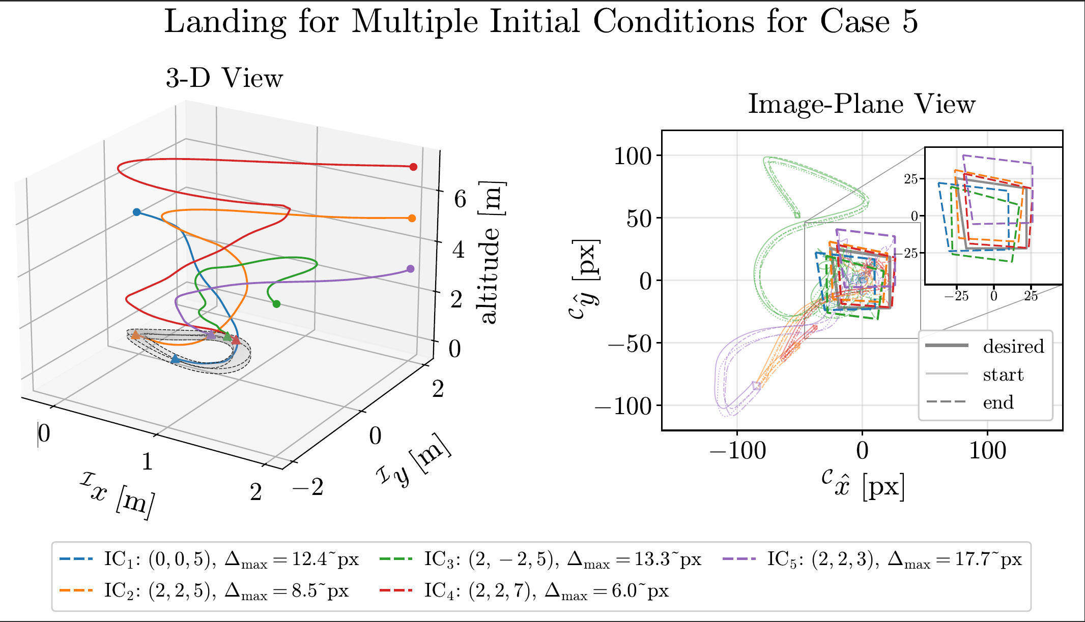
Simulation Results

Slide 19
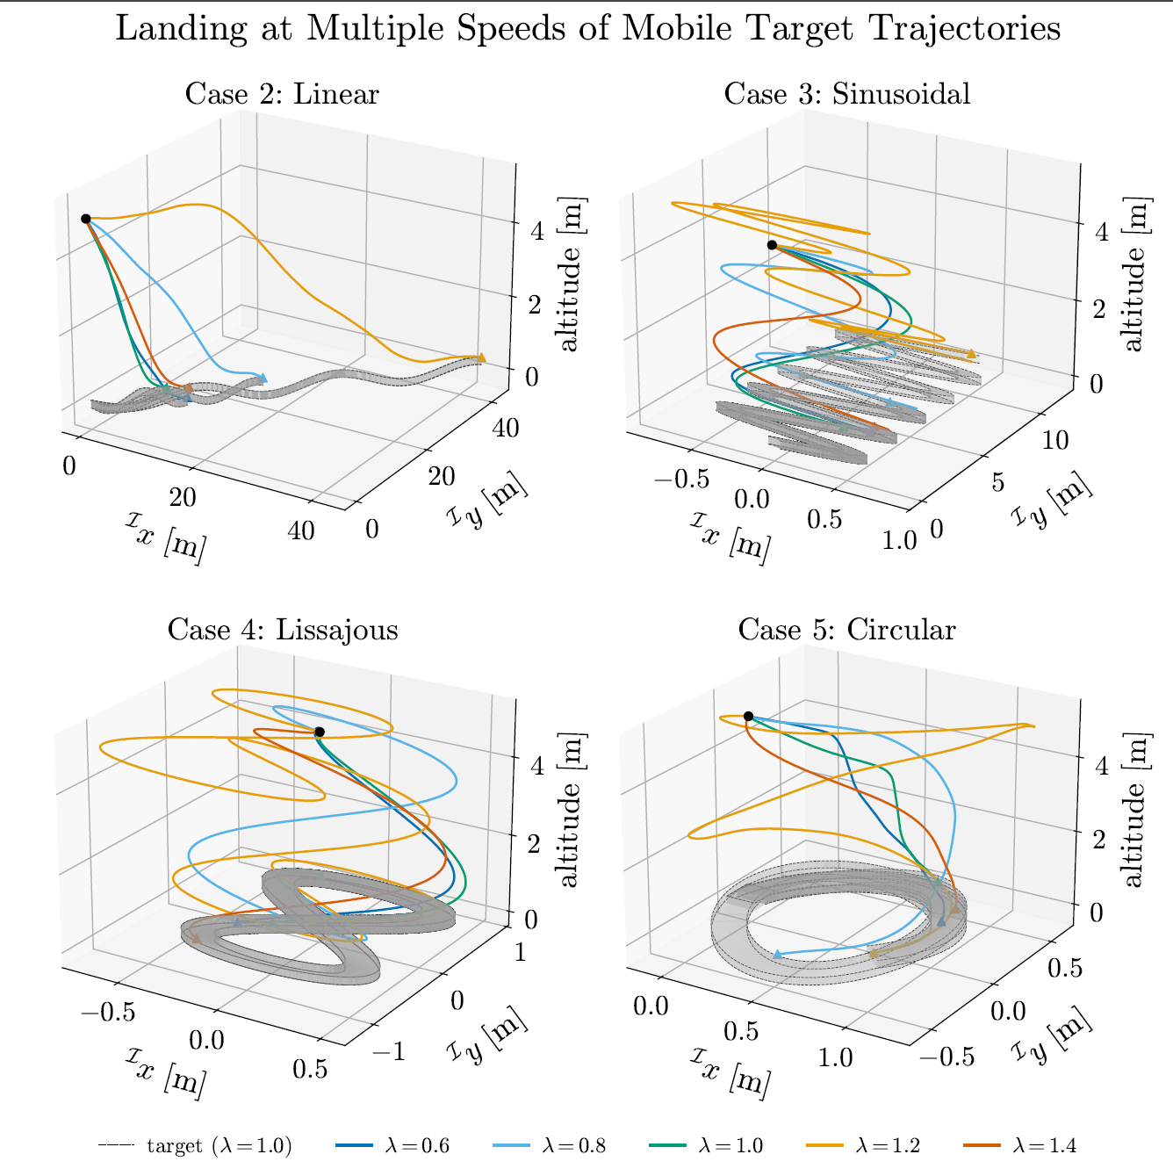
Simulation Results

Slide 20
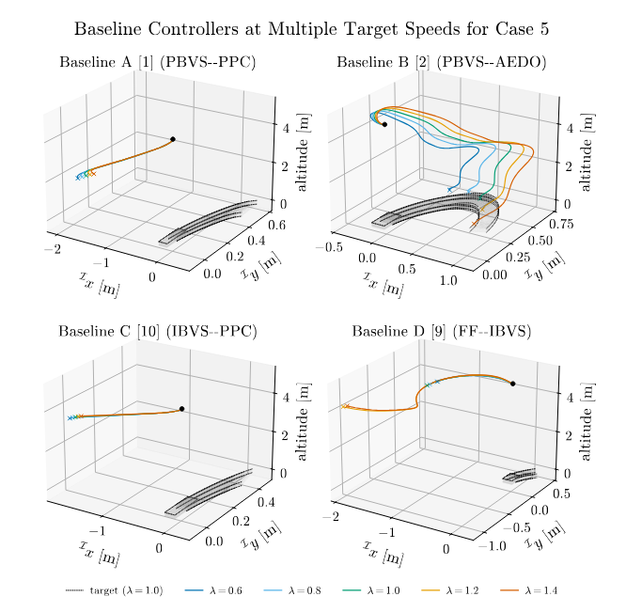
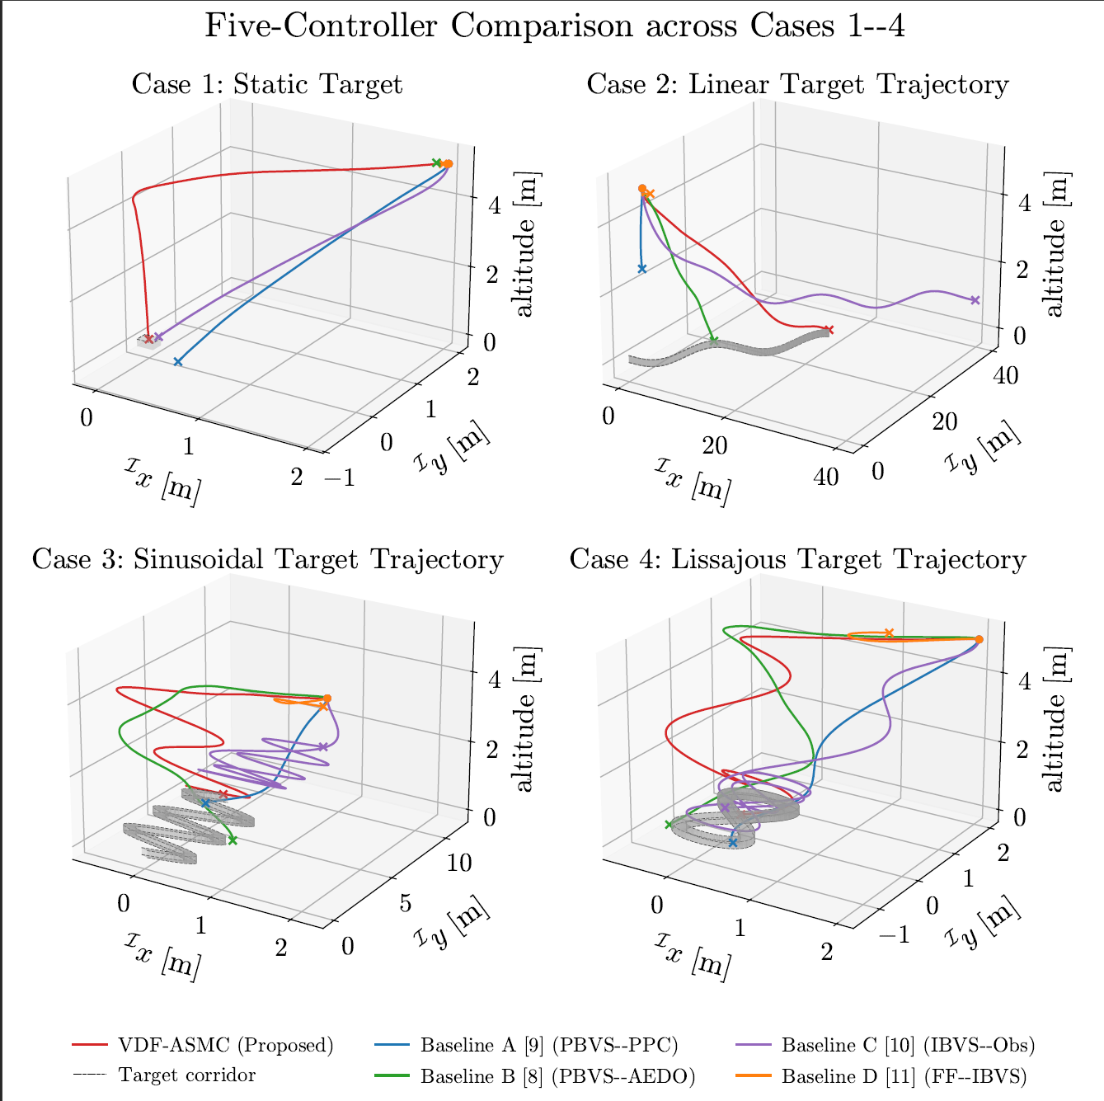
Simulation Results

Slide 21
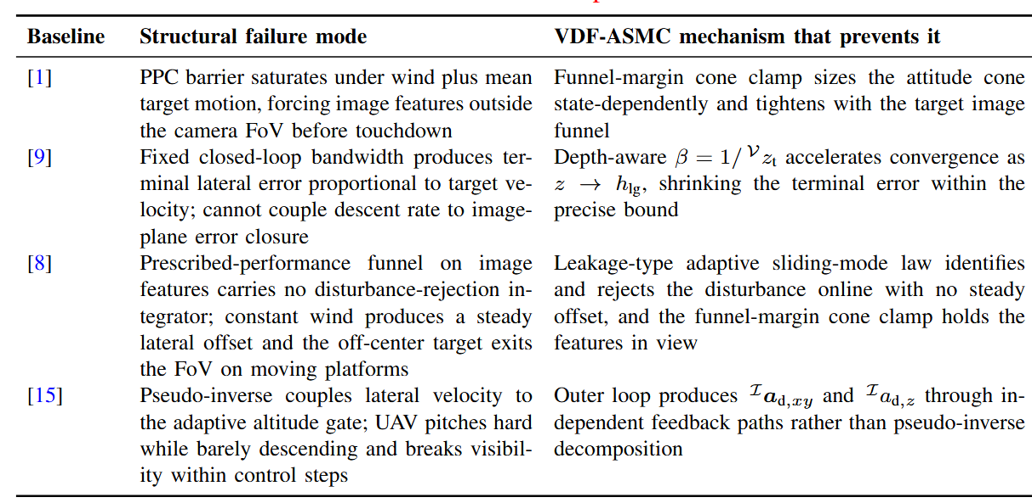
Failure Analysis
[Lin 2022 IEEE TII]
[Zhang 2026 IEEE TIE];
[Lin 2023 IEEE TASE]
[Cho 2022 Aerosp. Sci. Technol.]

Slide 22

Work Progress on Gazebo SITL
Implementation pipeline:
Setup connection with Flight Controller using MAVSDK.
Accessed clock, pose and image data from Gazebo simulator.
Designed nested aruco marker.
On-going tuning of control parameters for the proposed controller.
Input calibration:
Completed for angular velocities and body thrust.
Output calibration:
Issues in computing image features and optical flow in virtual image plane.

Slide 23
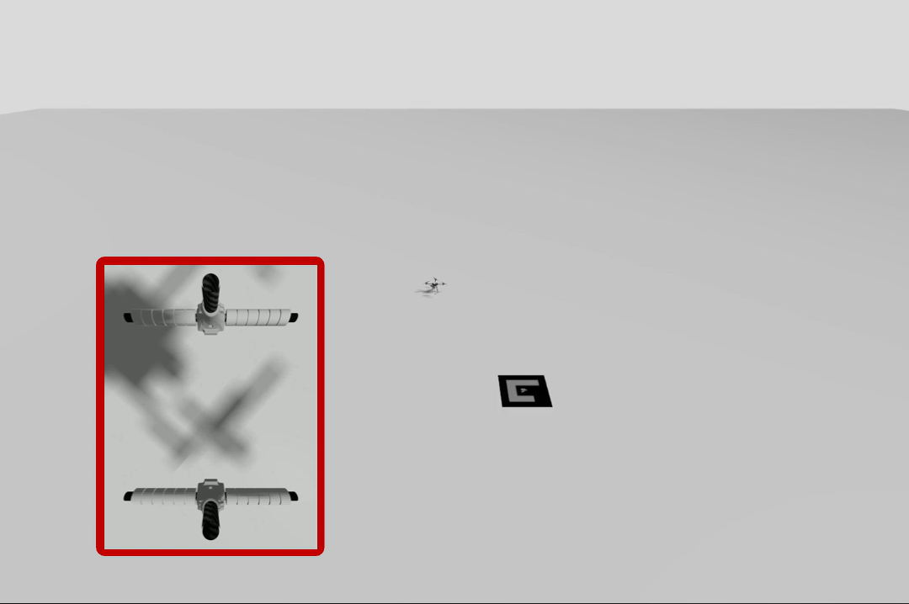
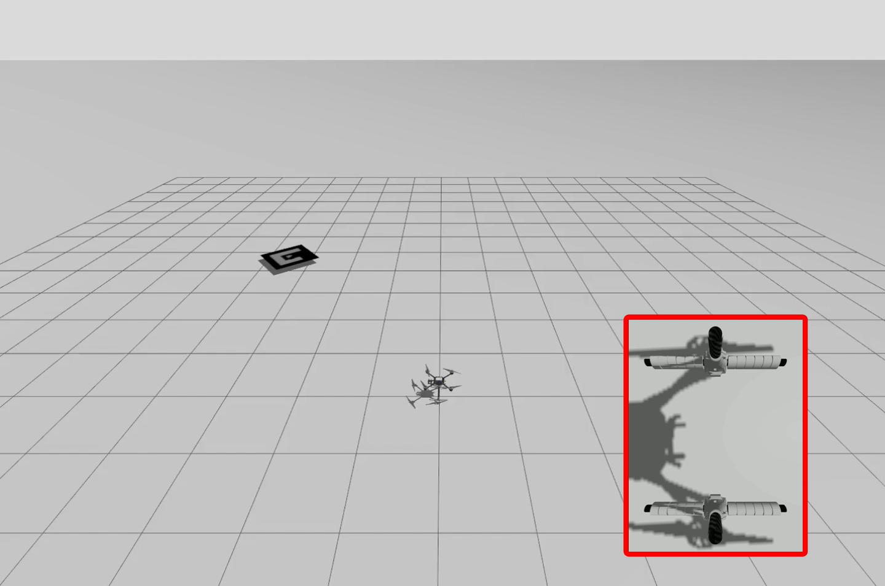
Key Demonstrations with Gazebo SITL
Soft precise landing on a stationary platform.
Soft precise landing on a mobile platform.
These demonstration videos are recorded in Gazebo simulator using GNSS-based PID controller

Slide 24
Work Progress on Experimental Hardware
Implementation pipeline:
Setup connection with Flight Controller using MAVSDK.
Achieved image feed of more than 40 Hz using Raspberry Picamera.
Achieved computational speed of more than 90 Hz on Raspberry Pi.
Tested with nested aruco marker.
Control parameters to be tuned.
Input and output calibration:
To be calibrated.

Slide 25
Summary
Addresses the image-based soft-precise landing problem of a low-SWaP-C quadrotor on an unpredictable moving vehicle
Scale-independent approach offers higher precision in target tracking and landing.
Numerical simulations under realistic disturbance settings validate robustness against:
Variation in the quadrotor's initial state,
Variation in the target state,
Variation in the target dynamics
Achieves soft-precise landing with a mean landing time of at most 18.2 s and a horizontal error within 5.8 cm.
Only controller to achieve soft-precise landing on every trajectory in comparison to four state-of-the-art baselines
Discussed work progress on Gazebo simulation and experimental hardware.
Discussed ongoing collaboration projects.
Notes:
Let me summarize the presentation for you all.
First we proposed a robust adaptive control strategy to execute a constant flow divergence landing maneuver while driving the vertical velocity of the quadrotor to zero.
The novelty of our work lies in the implementation of adaptive first-order sliding mode control (AFOSMC) strategy that drives the output error to zero through online estimation and rejection of the model uncertainties and exogenous perturbations.
Numerical simulation and flight tests results exhibit the effectiveness of the proposed control approach and its robustness against uncertainties and perturbations.
Finally, a performance comparison analysis is performed with a fixed-gain PI controller to demonstrate the superiority of the proposed controller.

